Slide 1
Simulation of different selfish mining strategies in Bitcoin respecting network topology and reference implementation
DIPLOMA THESIS
Simon Mulser, BSc
Advisor: Edgar Weippl, Privatdoz. Mag.rer.soc.oec. Dipl.-Ing. Dr.techn.
Assistance: Aljosha Judmayer, Univ.Lektor Dipl.-Ing.

Slide 2
What is selfish mining?
An attack on the Bitcoin mining process, where the attacker can increase its relative gain compared to other miners in the network. The attack compromises idea that the other miners waste their mining power for blocks, which will not end up in the longest chain.

Slide 3
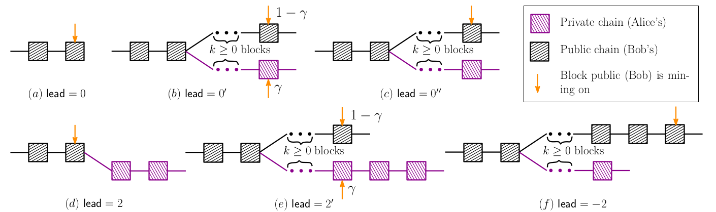
Selfish mining (1)
Nayak, K., Kumar, S., Miller, A., & Shi, E. (2016, March). Stubborn mining: Generalizing selfish mining and combining with an eclipse attack. In Security and Privacy (EuroS&P), 2016 IEEE European Symposium on (pp. 305-320). IEEE.

Slide 4
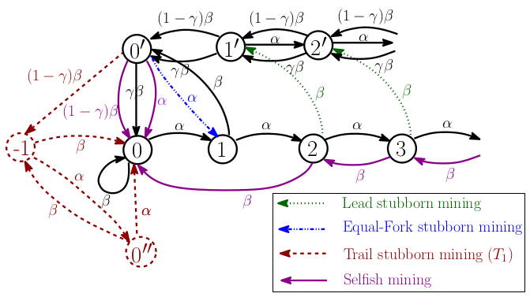
Selfish mining (2)
Nayak, K., Kumar, S., Miller, A., & Shi, E. (2016, March). Stubborn mining: Generalizing selfish mining and combining with an eclipse attack. In Security and Privacy (EuroS&P), 2016 IEEE European Symposium on (pp. 305-320). IEEE.

Slide 5
Goals (1)
Development of a novel, near-deterministic simulation framework which:
naturally respects the peer-to-peer network and its latency
directly reuses the reference implementation to capture all protocol details and to avoid time-consuming and error-prone adaptation or abstraction of the protocol
And, implement selfish mining strategies in a proxy which eclipses a normal node.

Slide 6
Goals (2)
Afterwards:
Simulate different selfish mining strategies under a realistic scenario
Investigate best performing strategies and compare them with honest mining
Contrast and validate the obtained results with simulations of previous research

Slide 7
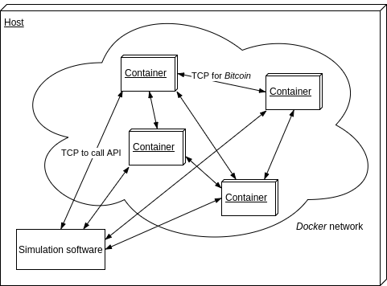
Simulation framework
Available under: github.com/sbaresearch/simcoin

Slide 8
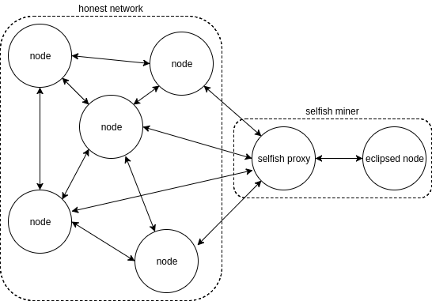
Selfish proxy
Notes:
A node in the network which eclipses a normal Bitcoin node from the rest of the network. By withholding blocks from the eclipsed node to the honest network and vice versa, the selfish proxy is able to mimic different selfish mining strategies.

Slide 9
Simulation scenario
The simulation scenario is a simplification of the real world Bitcoin network:
20 miners
All of them are connected with each other directly
One miner is eclipsed by the selfish proxy
Simulation of two weeks of Bitcoin in 100 minutes (200x faster)
No transactions and hence, empty blocks
Notes:
Therefore we defined a near-deterministic behaviour and checked against it.
Compared the stale-block rate
Checked ram and cpu utilisation

Slide 10
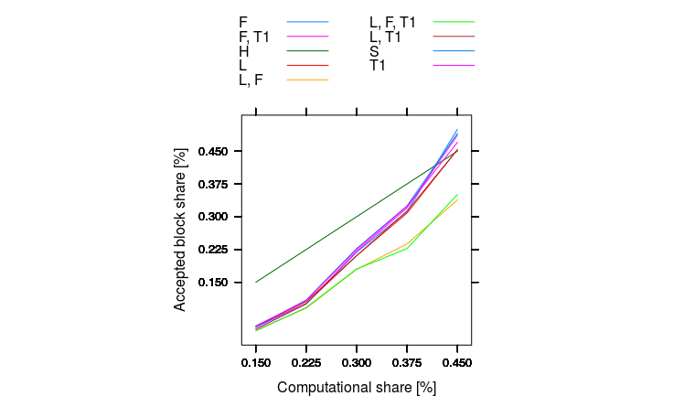
Simulation: Relative gain of selfish miner

Slide 11
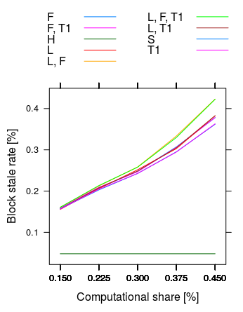
Simulation: Stale rate

Slide 12
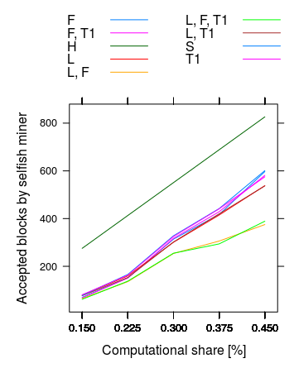
Simulation: Accepted blocks by selfish miner

Slide 13
Evaluation
The selfish miner can increase its relative gain by conducting selfish mining.
But:
Over 40% of the mining power of the network is needed
And the strategies normal selfish mining (S) or equal-fork stubbornness (F) need to be used
Then, the miner is able to increase its relative gain 4.1% and 5% respectively.

Slide 14
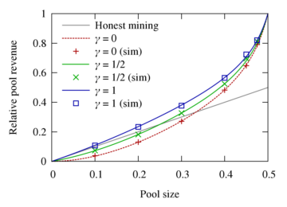
Compared to previous research
The simulation results are comparable with results from previous research where the miner does not win any block race.
In our simulation, the attacker is not able to win block races because of the realistic simulation scenario and the disadvantages of the selfish proxy.
Eyal, I., & Sirer, E. G. (2014, March). Majority is not enough: Bitcoin mining is vulnerable. In International conference on financial cryptography and data security (pp. 436-454). Springer, Berlin, Heidelberg.

Slide 15
Further research
Performance selfish proxy:
Use compact block relay mechanism to process blocks faster
Remove extra hop by implementing strategies directly in a Bitcoin reference implementation
Scenario:
Investigate in combining selfish mining with other known attacks
Use transactions in scenario and thus, bigger blocks

